Slide 1
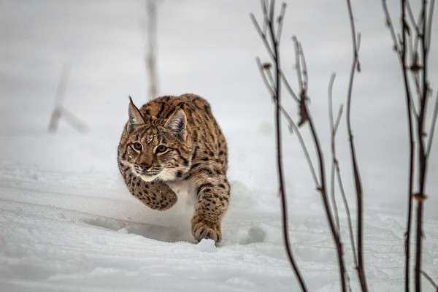
Species in the balance: partnering on tools and incentives for recovering Canadian species at risk
Smart Prosperity Institute Webinar Series February 14, 2018

Slide 2
About Smart Prosperity Institute
National research network and policy think tank based at the University of Ottawa
Delivering world-class research and working with public and private partners – all to advance practical policies and market solutions for a stronger, cleaner economy
Strong research foundation in environmental markets, payments for environmental services and biodiversity offsets

Slide 3
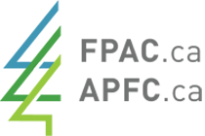
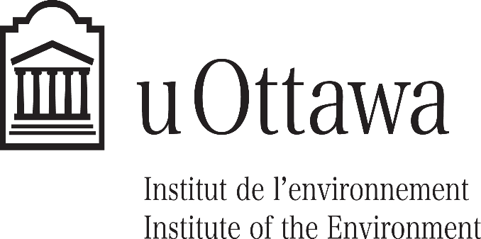
Project partners and funders

Slide 4
Methods
In-depth literature review
Stakeholder workshop and presentation to Canadian Wildlife Director’s Committee meeting
Semi-structured interviews with 35+ species at risk (SAR) experts
Survey of views of 100+ SAR recovery experts and practitioners in Canada, United States and Australia

Slide 5
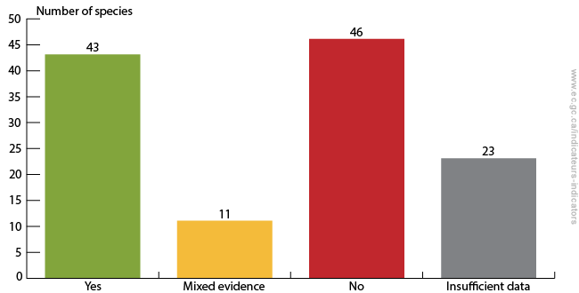
Trends
Are population trends of species at risk consistent with recovery strategy objectives?
Approximately 1/3 of re-assessed species at risk show population trends not consistent with recovery strategies (ECCC 2017)
Of the 350+ imperiled species in Canada which have had status reassessments, the status of over 85% is either unchanged or deteriorated (Favaro et al. 2014)
(Environment and Climate Change Canada 2017)

Slide 6
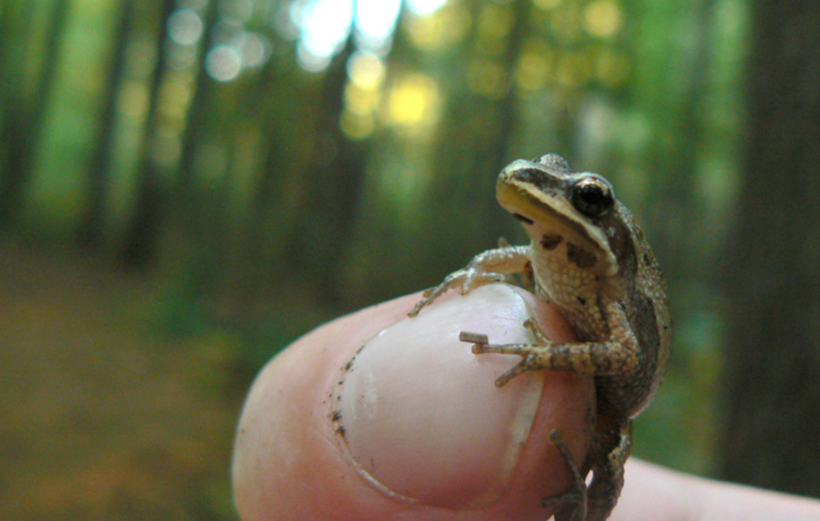
Key threats
Broad consensus that key threats to SAR consist of:
Residential and commercial property development
Natural systems modification
Human disturbance
(e.g. Prugh et al. 2010; McCune et al. 2013)
Notes:
Other threats include
Invasive species, genes and diseases
Biological resource use (logging, fishing, etc.)
Energy production and mining
Transportation and service corridors
Agriculture

Slide 7
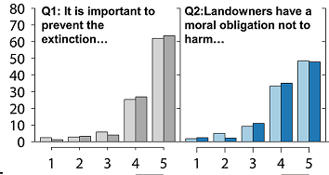
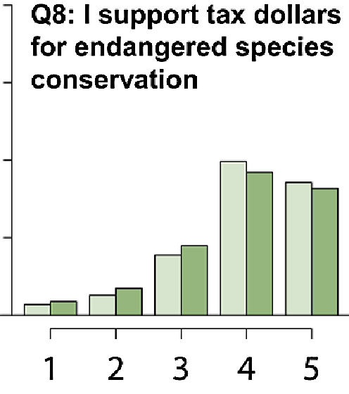
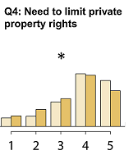
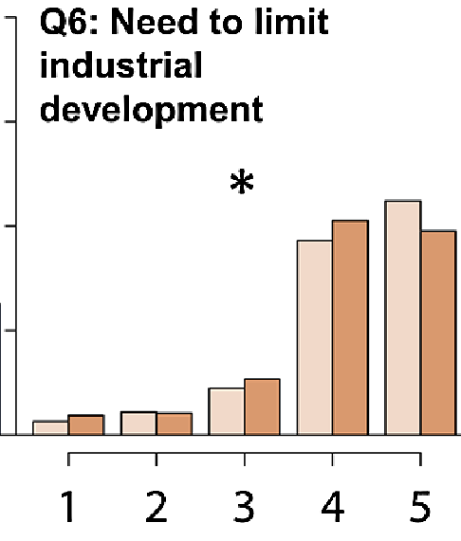
Attitudes
Canadians overwhelmingly support action on species at risk (Q1), and are willing to pay taxes to protect them (Q8)
But that support dips if it’s seen as limiting private property rights (Q4) or industrial development (Q6)
Need collaborative models
(McCune et al. 2017)
Notes:
Asterisks indicate a significant difference in the response between versions A (conservation) and B (utilitarian) answers. (5= most pro-conservation response, 1= least pro-conservation response)

Slide 8
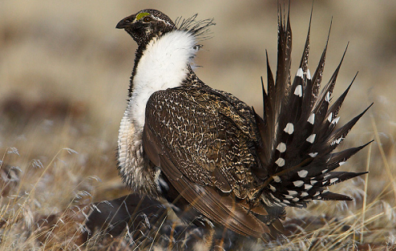
Challenges
Room for improvement acknowledged by nearly all parties
Gaps in protection on non-federal land
Limited scope of federal protections under the Act
Need to work with P/T governments who have broader conservation mandate
Involving private landholders in SAR conservation and recovery

Slide 9
Challenges
Canadian respondent perceptions of SAR conservation and recovery outcomes from complementary tools
Policymakers are using a somewhat narrow set of tools
Little use of complementary tools despite strong public interest, e.g.
Economic instruments
Place-based (multispecies and ecosystem) approaches
(Smart Prosperity Institute, Species at Risk survey)

Slide 10
Challenges
Canadian respondent perceptions of overall public support for SAR policies and programs if complementary tools were used more frequently
Policymakers are using a somewhat narrow set of tools
Little use of complementary tools despite strong public interest, e.g.
Economic instruments
Place-based (multispecies and ecosystem) approaches
(Smart Prosperity Institute, Species at Risk survey)
Notes:
(Strong consensus that place-based approaches and EIs and would likely improve support for SAR policies and programs, although government stakeholders less convinced that PBAs would enjoy increased public support).

Slide 11
Resource constraints
Canadians respondents’ ranking of most desired factor for improving SAR outcomes by organization type
Consensus that too few resources are devoted to action plans, stewardship
Strong recognition of importance of additional funding from governments and ENGOS
Political will another major requirement for success
(Smart Prosperity Institute, Species at Risk survey)

Slide 12
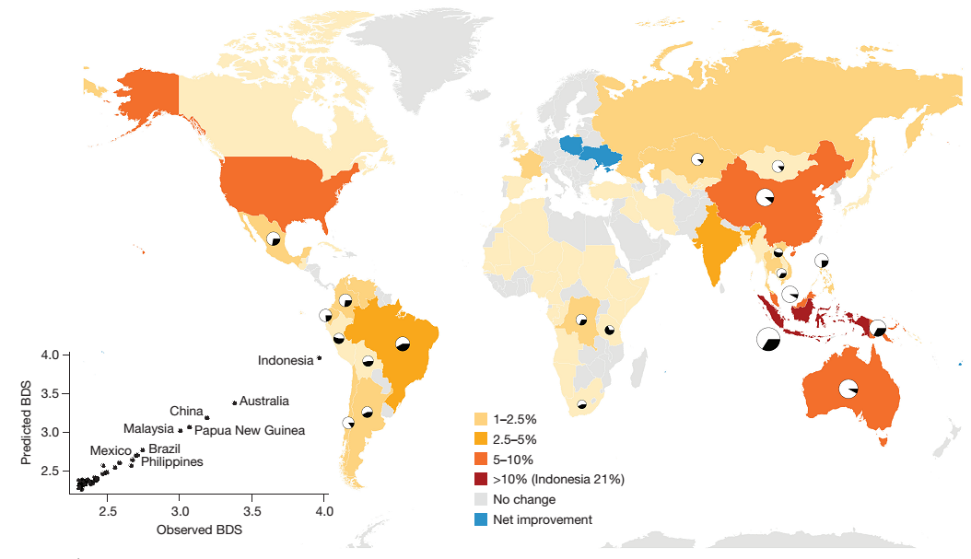
Conservation spending matters
Studies of the US ESA shows that increased spending slows listed species declines (e.g. Kerkvliet and Langpap 2007; Ferraro et al. 2007)
A recent global study shows that spending on endangered bird and mammal conservation since the Earth Summit reduced median per country species loss by 29% (Waldron et al. 2017)
(Waldron et al. 2017)
Notes:
*Waldron et al. (2017) did not quantify effects for Canada due to shortcomings in data.

Slide 13
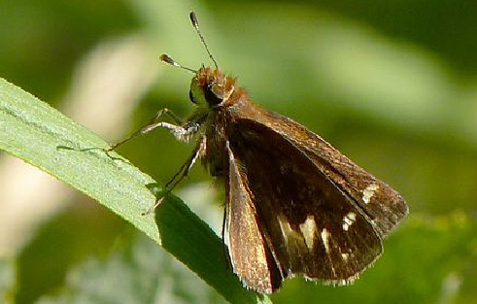
Solutions
Harnessing a suite of economic instruments
Permits and offsets on crown land
Protecting critical habitat on private land
Addressing non-habitat threats
Increasing funding for species at risk conservation, e.g.
Municipal referenda for local property tax increases
Carbon pricing revenues
Green bonds

Slide 14
Economic instruments 101
Canada makes little use of economic instruments for wildlife conservation compared to peer countries (Kenny et al. 2011; Adamowicz 2016)
SAR stewardship programs primarily consist of extension and cost-share activities
Potential benefits of economic instruments include:
May encourage conservation activities at greater scale
Incentives for continuous improvement
Improved cost-effectiveness relative to regulatory approaches
Some instruments can provide revenues for further conservation efforts
Notes:
Some economic instruments are better suited to remediating key threats than others – need to assess them on a case-by-case basis
Some economic instruments are more applicable to certain land ownership categories than others

Slide 15
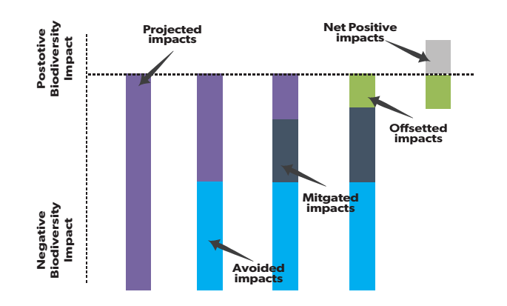
Permits and offsets
The mitigation hierarchy
Proposed federal permit policy could provide template for P/T governments (ECCC 2016)
Adheres to mitigation hierarchy
Offsets must ensure a net gain to SAR
Allows banking to reward early action, increase likelihood of success (Bekessy et al. 2010)
(Source: Brownlee 2014)
(Adapted from the Biodiversity Consultancy, undated)
Notes:
(Partnering with the provinces on offsets – e.g. parallel P/T permitting or offset legislation, section 11 agreements)

Slide 16
Permits and offsets
Rigorous approach needed to manage risks, e.g.
Recognize limits to offsets (e.g. Curran, Hellweg, and Beck 2014)
Banking/early action
Using rigorous multipliers to adjust for time lags and risks (e.g. Laitila Moilanen Pouzols)
Penalize projects which underperform on mitigation and compensation measures (incentivizes accuracy)
Monitor and learn lessons!
Partnering with the provinces and territories on offsets
Notes:
(Many existing offset schemes have failed to deliver on no net loss objectives) (Partnering with the provinces on offsets – e.g. parallel P/T permitting or offset legislation, section 11 agreements)

Slide 17
Protecting habitat on private land
Easements an effective SAR conservation tool on private land, e.g.
$100 million in targeted easements in mid-western and northwestern U.S. could reduce potential future losses of sage grouse on farmland by around 80% (Smith et al. 2011)
Land with high suitability for waterfowl habitat was more likely to be targeted for easements in Manitoba (Lawley and Towe 2014)
Successfully targeting ag. land at risk of conversion in Canada & U.S. (Fishburn et al. 2009; Lawley and Towe 2014)
PES piloted by ALUS in Ontario (McCracken et al. 2014)

Slide 18
Protecting habitat on private land
Key lessons
Need to be explicitly targeted to ensure value for money
Trade-off with flexibility/simplicity for increasing participation
Consider alternative approaches to lower program costs (e.g. reverse auctions; revolving restoration funds)
Adopt experimental or quasi-experimental approach

Slide 19
Local referenda
USD $76 billion in bonds and taxes raised for land conservation in the U.S. from 1988-2017 (TPL undated)
Some Canadian initiatives
B.C. Capital Regional District
Regional District of East Kootenay
Regional District of Okanaga-Similkameen
Conditions for success:
Creating coalitions of interests
Communicating recreational, environmental and health benefits
Notes:
These ballot measures have been passed in both Red and Blue states – it can be done! (Fraction of the proceeds would be used to acquire SAR habitat).

Slide 20
Non-habitat threats
E.g. invasive spp. and disease, biological resource use, pollution
Point and non-point source pollution
Water quality trading programs
Stewardship schemes (e.g. riparian vegetation)
Levies on wastewater, pesticides/fertilizers
Important co-benefits
(Author: IStock)
Notes:
Co-benefits include improved water quality, enhanced fish stocks for recreational angling etc.

Slide 21
Carbon pricing revenues
Coming into effect across the country in 2018
Political window - devoting half a percentage point to SAR conservation would contribute $tens of millions in additional funding
Other benefits (carbon sequestration, improved water quality, climate resilience)
Notes:
Note that revenues stay in provinces.

Slide 22
Green bonds
Combined $1.3 billion in green bonds issued by governments of Quebec and Ontario in 2017 (Boulle and Marcano 2017)
Financing capital-intensive habitat acquisition and restoration activities (e.g. $100 million needed for caribou habitat restoration and breeding facility) (Denhoff 2016)
Niche markets? Monetization of cost savings?
Notes:
(Niche markets willing to accept below-market rates of return?)

Slide 23
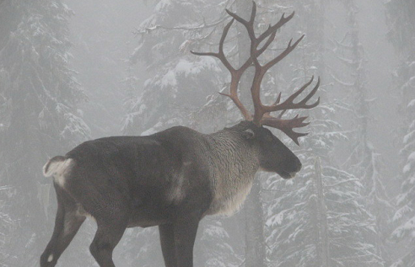
Thank you! Questions?
(Author: Steve Forrest)

Slide 24
References
Bekessy, Sarah A. et al. 2010. “The Biodiversity Bank Cannot Be a Lending Bank.” Conservation Letters 3(3): 151–58.
Boulle, Bridget, and Mercedes Marcano. 2017. “Bonds & Climate Change: The State of the Market 2017.” London: Climate Bonds Initiative and Smart Prosperity Institute. Retrieved from http://institute.smartprosperity.ca/2017greenbonds. (January 08, 2018). Curran, Michael, Stefanie Hellweg, and Jan Beck. 2014. “Is There Any Empirical Support for Biodiversity Offset Policy?” Ecological Applications 24(4): 617–32. Denhoff, Eric. 2016. “Setting Alberta on the Path to Caribou Recovery.” Report prepared for Alberta Environment and Parks. Edmonton: Alberta Environment and Parks. Retrieved from https://albertawilderness.ca/wordpress/wpcontent/uploads/2016/06/20160530_rp_goa_car_mediators_report_setting_ab_caribou_path_to_recovery.pdf (January 08, 2018).
Environment and Climate Change Canada. 2017. “Canadian Environmental Sustainability Indicators: Species at Risk Population Trends.” Gatineau: Environment and Climate Change Canada. Retrieved from https://www.canada.ca/en/environment-climate-change/services/environmental-indicators/species-risk-population-trends.html (January 08, 2018).
Favaro, Brett et al. 2014. “Trends in Extinction Risk for Imperiled Species in Canada.” PLoS ONE 9(11): e113118.
Ferraro, Paul, Craig McIntosh, and Monica Ospina. 2007. “The Effectiveness of the US Endangered Species Act: An Econometric Analysis Using Matching Methods.” Journal of Environmental Economics and Management 54: 245-261. Fishburn, Isla S., Peter Kareiva, Kevin J. Gaston, and Paul R. Armsworth. 2009. “The Growth of Easements as a Conservation Tool.” PLoS ONE 4(3): e4996.
Government of Canada. 2016. “Species at Risk Act Permitting Policy [Proposed].” Ottawa: Government of Canada. Species at Risk Act: Policies and Guidelines Series. Retrieved from http://registrelep-sararegistry.gc.ca/virtual_sara/ files/policies/Permitting_EN.pdf (January 08, 2018). Kerkvliet, Joe, and Christian Langpap. 2007. “Learning from Endangered and Threatened Species Recovery Programs: A Case Study Using U.S. Endangered Species Act Recovery Scores.” Ecological Economics 63(2–3): 499–510.

Slide 25
References
Laitila, Jussi, Atte Moilanen, and Federico M. Pouzols. 2014. “A Method for Calculating Minimum Biodiversity Offset Multipliers Accounting for Time Discounting, Additionality and Permanence.” Methods in Ecology and Evolution 5(11): 1247–54.
Lawley, Chad, and Charles Towe. 2014. “Capitalized Costs of Habitat Conservation Easements.” American Journal of Agricultural Economics 96(3): 657–72.
Mcracken, Jon D., Stuart A. Mackenzie, Sonya Richmond & Eva Jenkins. 2014. “Studies of Bobolink and Related Bird Habitats on Agricultural Lands in Norfolk County.” Report produced for Norfolk Alternative Land Use Services (ALUS). Retrieved from https://alus.ca/wp-content/uploads/2016/08/BobolinkStudy.pdf.
McCune, Jenny L. et al. 2013. “Threats to Canadian Species at Risk: An Analysis of Finalized Recovery Strategies.” Biological Conservation 166: 254–65. McCune, Jenny L. et al. 2017. “Assessing Public Commitment to Endangered Species Protection: A Canadian Case Study.” FACETS 2: 178-194. Prugh, Laura R. et al. 2010. “Reducing Threats to Species: Threat Reversibility and Links to Industry.” Conservation Letters 3(4): 267–76. Smith, J.T., J.S. Evans, B.H. Martin, S. Baruch-Mordo, J.M. Kiesecker, D.E. Naugle. 2016. “Reducing Cultivation Risk for At-risk Species: Predicting Outcomes of Conservation Easements for Sage-grouse.” Biological Conservation 201: 10–19. The Biodiversity Consultancy. Undated. “The Mitigation Hierarchy.” Retrieved from http://www.thebiodiversityconsultancy.com/approaches/mitigation-hierarchy/ (January 08, 2018). Trust for Public Lands. Undated. “TPL LandVote Database.” Retrieved from https://tpl.quickbase.com/db/bbqna2qct?a=dbpage&pageID=8 (January 08, 2018). Waldron, Anthony, Daniel C. Miller, Dave Redding, et al. (2017). “Reductions in global biodiversity loss predicted from conservation spending.” Nature 551: 364–367.

Slide 26
Resource constraints
Canadians respondents’ ranking of most desired factor for improving SAR outcomes by organization type
Consensus that too few resources are devoted to actions plans, stewardship
Strong recognition of importance of additional funding from governments and ENGOS
Political will another major requirement for success

