Slide 1
ACCELERATINGCLEAN INNOVATION IN CANADA
April 12, 2017
institute.smartprosperity.ca

Slide 2
Why Clean Innovation Matters
The global demand for clean innovation – new technologies, products and practices that improve environmental performance – is rapidly growing.
Accelerating the pace of clean innovation in Canada is not only an important tool for meeting climate and environmental goals, it also represents a critical economic opportunity across all Canadian sectors.
Canada’s cleantech sector can tap into a fast-growing global market that is expected to be worth as much as C$2.5 trillion by 2020.
Resource and manufacturing sectors can also benefit – McKinsey estimates that improvements in energy and resource efficiency will represent a C$3.8 trillion economic opportunity by 2030.

Slide 3
Why We Need a Clean Innovation Model
Accelerating clean innovation requires identifying the right places for government intervention and designing smart policies, which in turn requires an understanding of how clean innovation happens.
What drives and guides the search for new ideas and inventions?
How do these inventions get developed into commercially viable products?
And where is government help most needed to remove barriers and create incentives to foster clean innovation?
We consider 3 (consistent) models – the Stages model, the Systems model, the Evolutionary Geography model – and use a variation on the stages model that focuses on the main forces and actors involved in clean innovation

Slide 4
Stages of Clean Innovation

Slide 5
Actors: Researchers

Slide 6
Actors: Consumers

Slide 7
Actors: Private Investors

Slide 8
Market Failures in Clean Innovation

Slide 9
Market Failures in Clean Innovation

Slide 10
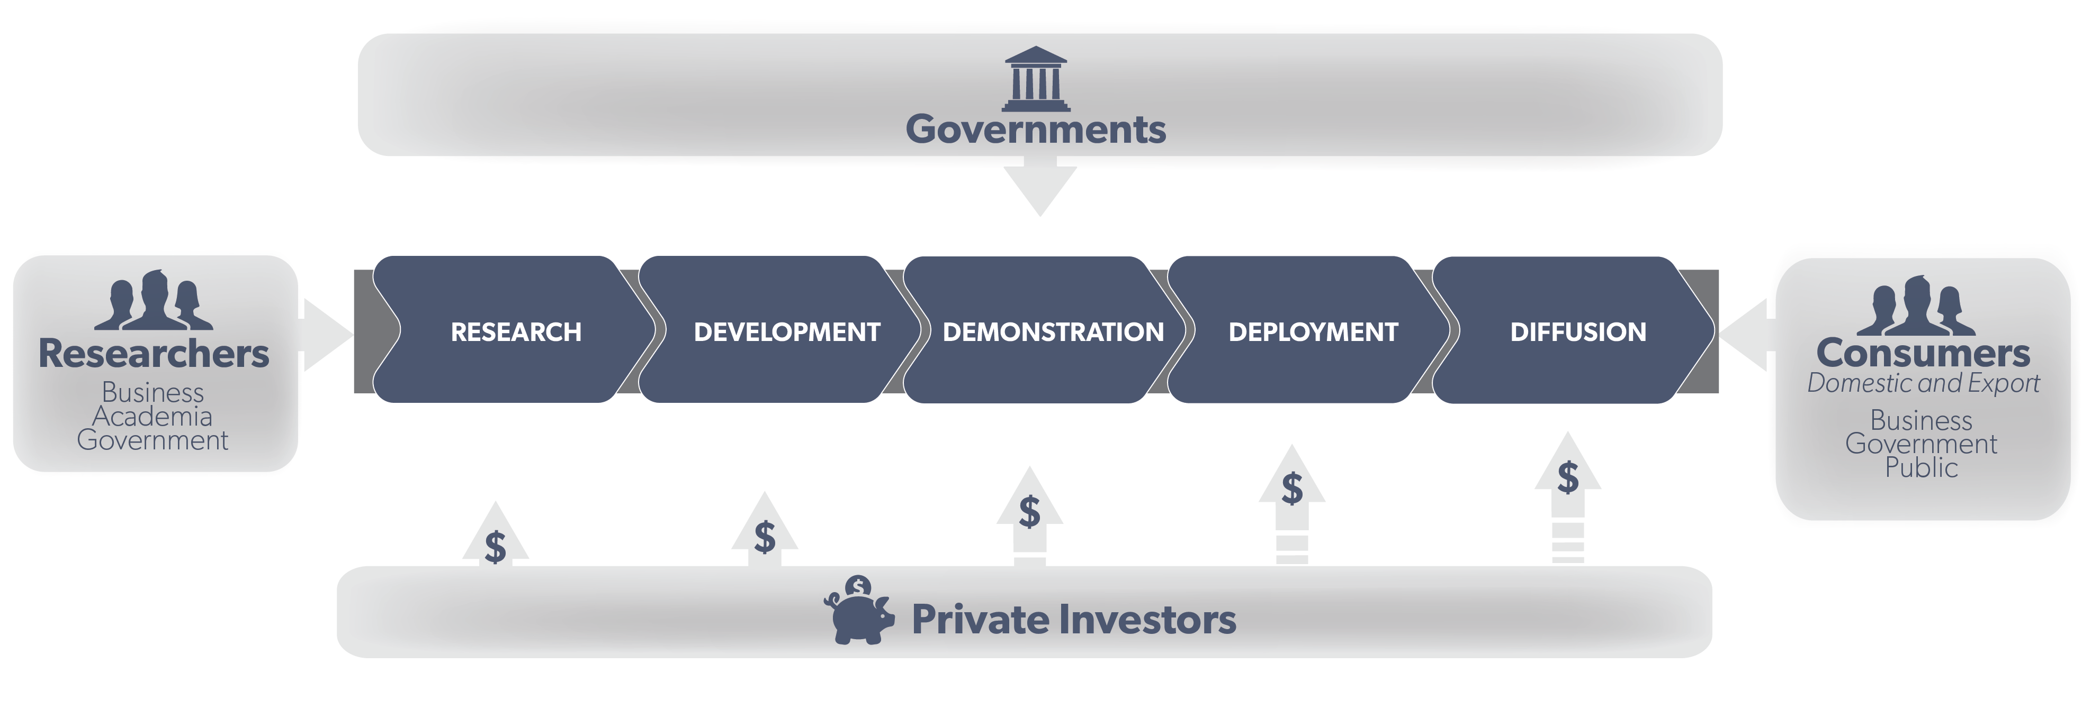
Role of Government in Clean Innovation?

Slide 11
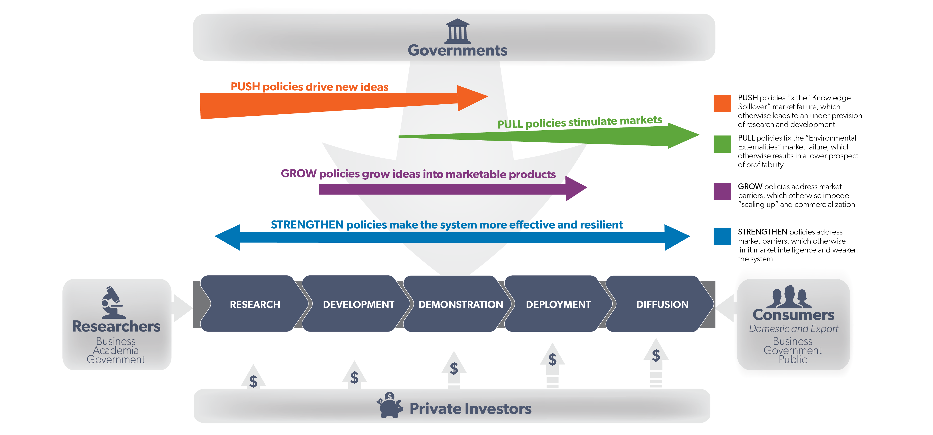
Our Clean Innovation Model

Slide 12
PUSH Policies and Clean Innovation

Slide 13
PULL Policies and Clean Innovation

Slide 14
GROW Policies and Clean Innovation

Slide 15
STRENGTHEN Policies and Clean Innovation

Slide 16
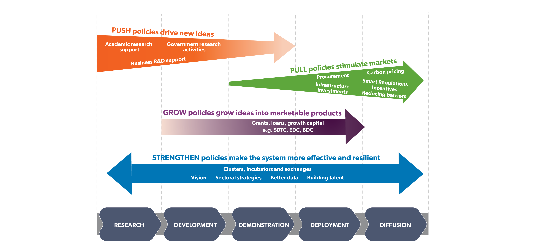
Clean Innovation Model: Detailed policy view

Slide 17
Our Clean Innovation Model

Slide 18
Looking Forward
Canadian governments have made substantial progress in recent months in building the policy architecture that will boost clean innovation
In December 2016, First Ministers signed the Pan-Canadian Framework on Clean Growth and Climate Change, which sets out a range of federal and provincial policy commitments designed to move Canada towards meeting its Paris climate targets and help stimulate low-carbon innovation
The recent 2017 federal budget builds on this framework by making a major investment in all stages of clean innovation, including in PUSH, PULL, GROW and STRENGTHEN
These new commitments are important, but they are just a start. Further federal, provincial/territorial and other actions and investments will be needed to secure Canada’s clean innovation future

Slide 19
Questions & Discussion
At the bottom of the PARTICIPANTS window, click the RAISE YOUR HAND button. You will then be unmuted and prompted by the moderator.
Contact
Michelle Brownlee
Director, Policy
michelle@smartprosperity.ca
613-408-0645
@MJ_Brownlee

